Slide 1
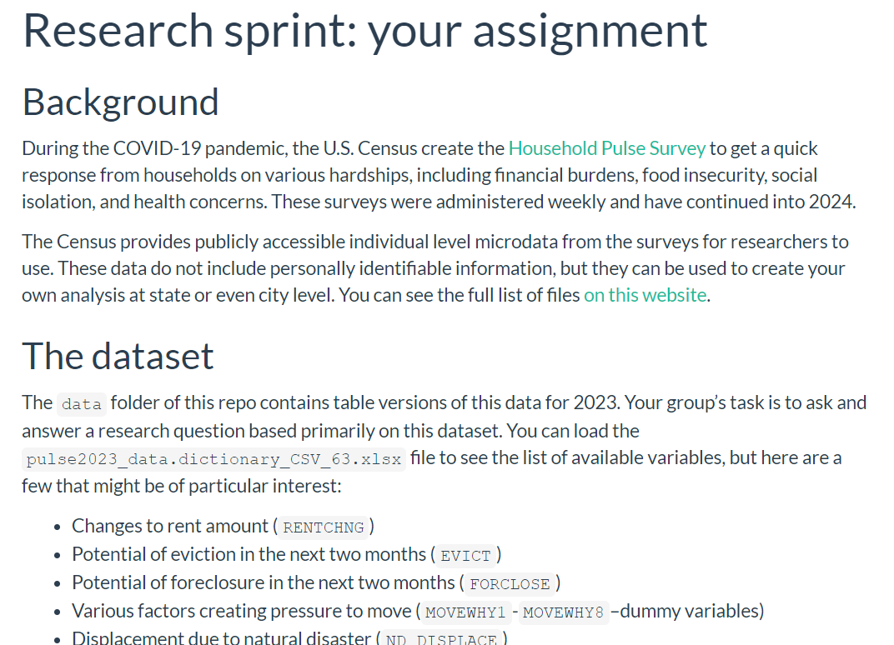
Research sprint activity
Geog4300: Shannon

Slide 2
What’s the goal?
Final practice creating a project from start to finish
Review of all the techniques we’ve covered this semester
Notes:
Alternative hypothesis is usually what you’re trying to prove.

Slide 3

Dataset: The Household Pulse Survey
Notes:
Alternative hypothesis is usually what you’re trying to prove.

Slide 4
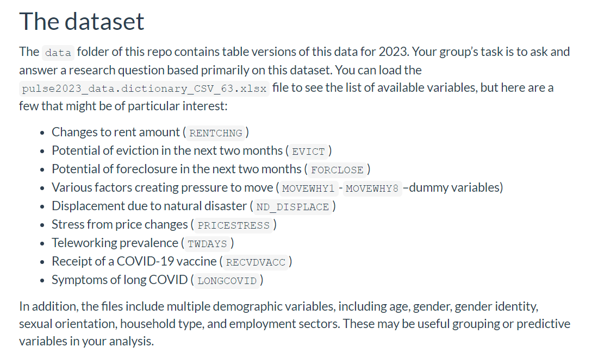
Potential variables of interest
Notes:
Alternative hypothesis is usually what you’re trying to prove.

Slide 5
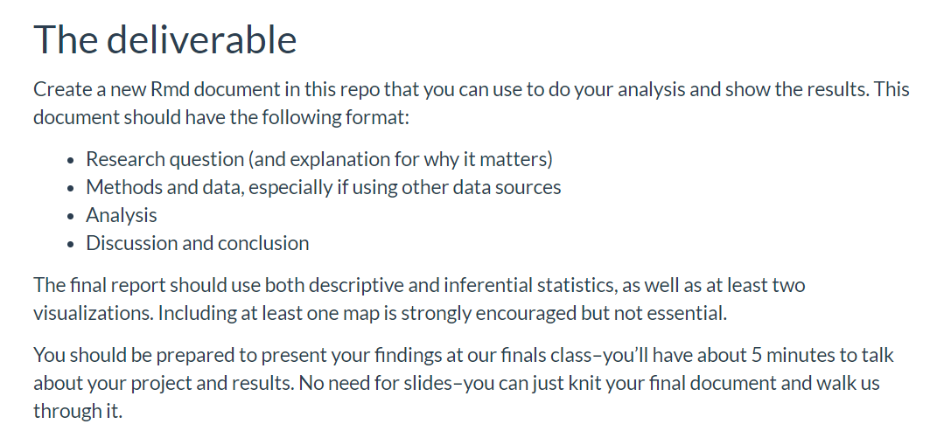
What is the deliverable?
Notes:
Alternative hypothesis is usually what you’re trying to prove.

Slide 6

What questions could we ask?
Notes:
Alternative hypothesis is usually what you’re trying to prove.

Slide 7
In your groups: Design a workflow
What’s your final question?
What variables will you be using?
Will you need any additional datasets?
Diagram the steps of your analysis.
Which tests/methods are you using and why?
What assumptions/diagnostics do you need to check?
What visualizations will you be adding?
You’ll use Thursday’s class to actually do this analysis
Notes:
Alternative hypothesis is usually what you’re trying to prove.

